Slide 1

ATTRITION ANALYSIS

Slide 2
BUSINESS OBJECTIVE

Slide 3
INTRODUCTION
Attrition rate is a calculation of the number of individuals or items that vacate or move out of a larger, collective group over a specified time frame.
In business, attrition is the number of people who move out of a group or company over time. It is a measure of employee turnover.

Slide 4
OBJECTIVE
This project takes the Attrition data and uses machine learning models to predict the employees who will be more likely to leave given some attributes.
The prediction model would help an organization predict employee attrition and define a strategy to reduce the rate attrition.

Slide 5
BUSINESS PROBLEM
The goal of this project is to analyse how objective factors influence employee attrition, in order to identify the main causes that contribute to a worker’s decision to leave a company.
The business problem is to predict whether a particular employee will leave the company.
The main factors related to the employee’s attrition is identified and a clustering algorithm is implemented to identify the class variable or clusters.
Agglomerative Hierarchical Clustering is applied to identify the binary classes.

Slide 6
WORK PROCESS
IDENTIFYING CLUSTER
Data Exploration
Data Preprocessing
Splitting Data for Training and Testing
Preparing a Clustering Model
CLASSIFICATION
Modelling Algorithm
Training the Model
Running Predictions On the Model
Evaluating and Visualizing Model Performance

Slide 7
EXPLORATORY DATA ANALYSIS

Slide 8
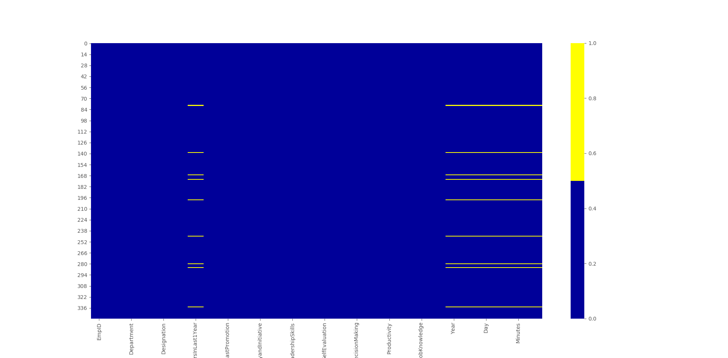
DATA PREPROCESSING
Null values (yellow cells) are replaced by the mean values of the feature.
Categorical variables converted to numeric variables by One Hot Encoding method.
Data is normalized to change the values of numeric columns in the dataset to a common scale.
As EmpId, EmpName, Department, Designation, Education Level, SelfEvaluation, Improvement Area are insignificant, these features are dropped from the process.

Slide 9
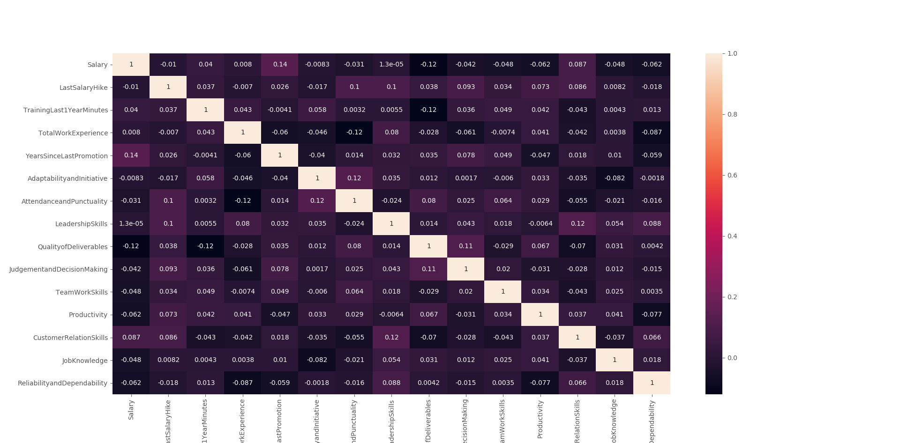
CORRELATION MATRIX
Correlation matrix produced to ascertain the correlations between the input features.
Input features are independent of each other.

Slide 10
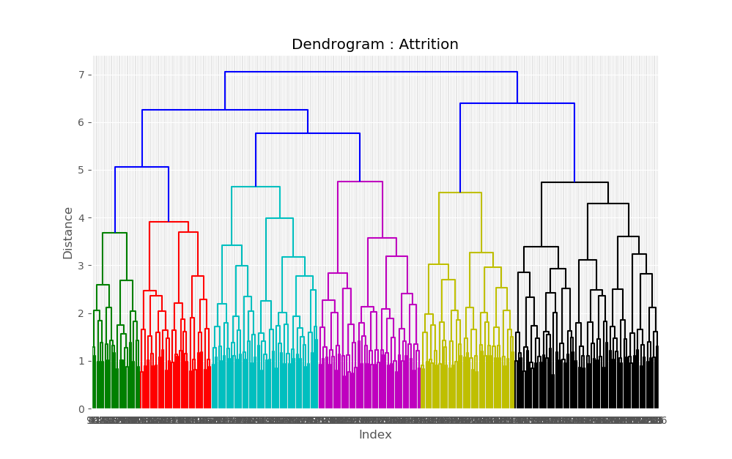
HIERARCHICAL CLUSTERING
Cluster 1
Cluster 0
Cluster 2
Cluster 3
Hierarchical Clustering is implemented to identify the classes and obtain the number of employee attrition.
ASSUMPTIONS
Cluster 1/Class 1 deduced as temporary employee.
Cluster 2/Class 2 is identified as employees who left the company.
Cluster 3/Class 3 deduced as contractual employee.
Cluster 4/Class 4 deduced as permanent employee.

Slide 11
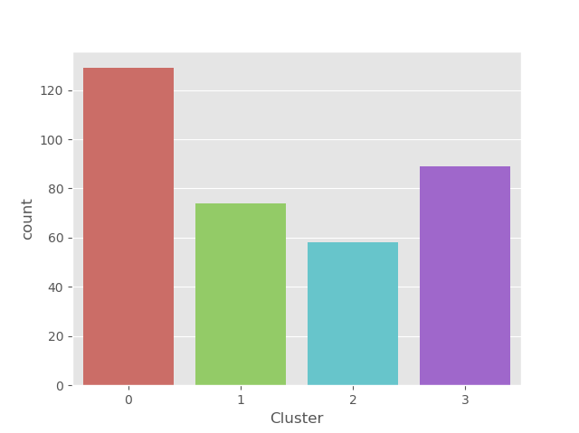
CLASSIFICATION
Source : https://hr.economictimes.indiatimes.com/
Cluster identified as left company
As per Deloitte India’s 2020 Workforce and Increment Trends Survey, attrition at an all India level in the current fiscal year is about 15%.
ASSUMPTIONS
Cluster 0/Class 0 deduced as permanent employee.
Cluster 1/Class 1 deduced as temporary employee.
Cluster 2/Class 2 deduced as employees who left the company.
Cluster 3/Class 3 deduced as contractual employee.
36.9%
21.1%
16.6%
25.4%
Permanent
Temporary
Left
Contract

Slide 12
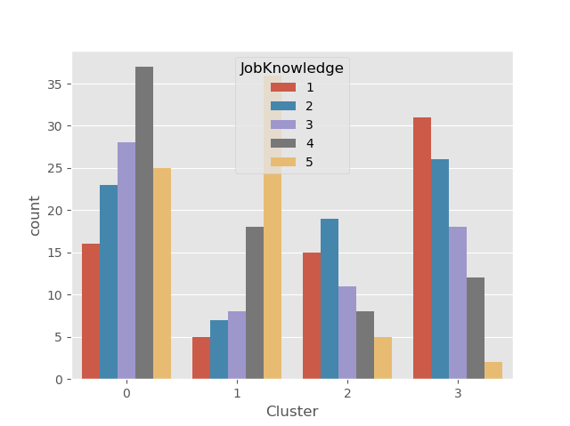
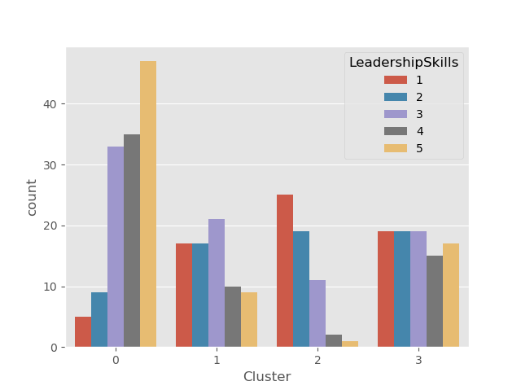
VISUALIZATION

Slide 13
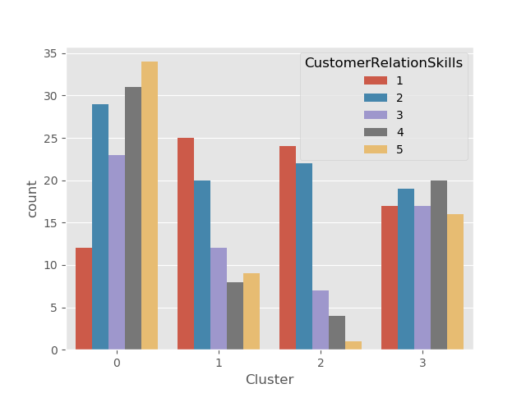
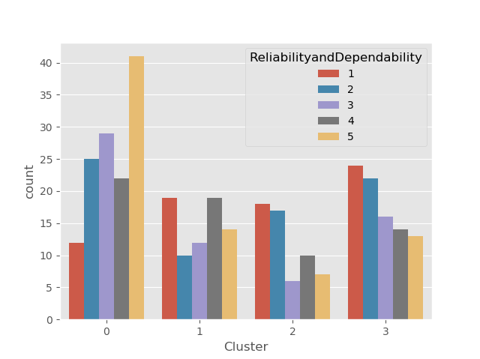
VISUALIZATION

Slide 14
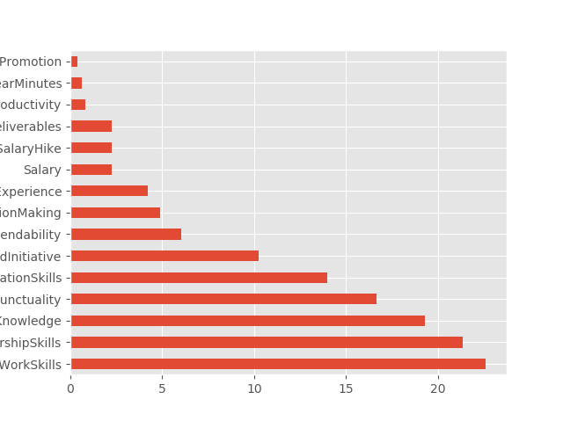
FEATURE SELECTION
Feature selection performed to select the features that contribute the most to the prediction output.
Productivity, TrainingLast1YearMinutes and YearsSinceLastPromotion with Scores of less than 1 are dropped from the dataset before the analysis.
Feature | Score
TeamWorkSkills | 22.60287323
LeadershipSkills | 21.31752782
JobKnowledge | 19.28941563
AttendanceandPunctuality | 16.65986633
CustomerRelationSkills | 13.99137205
AdaptabilityandInitiative | 10.21660968
ReliabilityandDependability | 6.043676228
JudgementandDecisionMaking | 4.874209447
TotalWorkExperience | 4.190470685
Salary | 2.267260016
LastSalaryHike | 2.245297201
QualityofDeliverables | 2.233262126
Productivity | 0.822476619
TrainingLast1YearMinutes | 0.6418402
YearsSinceLastPromotion | 0.382304113

Slide 15
MODEL BUILDING
The modelling process consists of selecting models that are based on various machine learning techniques used for classification.
Various predictive models were used such as those based on decision tree, Random Forest, logistic regression and SVM.
The objective is to identify the best classifier for the analysed problem.
Each classifier is trained on the featured set and the classifier with the best classification results is used for prediction.

Slide 16
OPTIMIZATION
Hyperparameter tuning is performed to determine the optimal values for a given model.
GridSearchCV is used to automate the tuning of the hyperparameters.
The classification algorithms taken into consideration are:
• Logistic Regression,
• Random Forest,
• Support Vector Machine (SVM) classification,
• Decision Tree classifier,
• Neural Network,
• K-nearest Neighbor (KN-N)

Slide 17
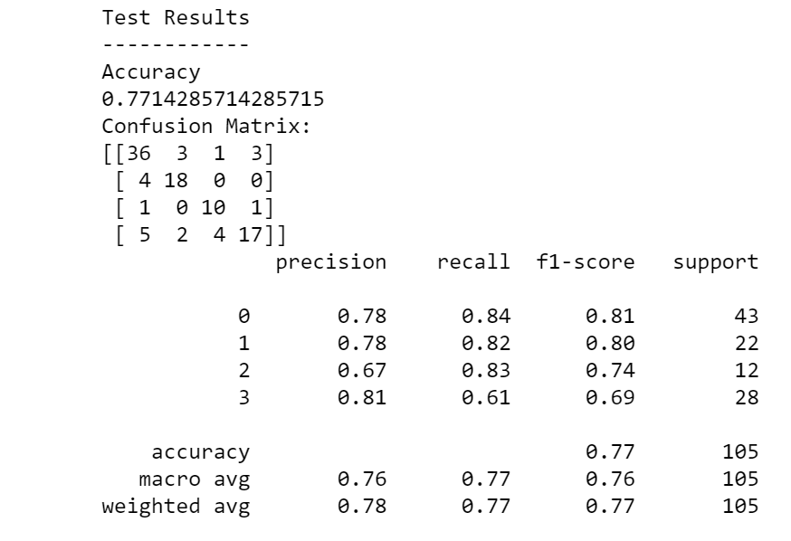
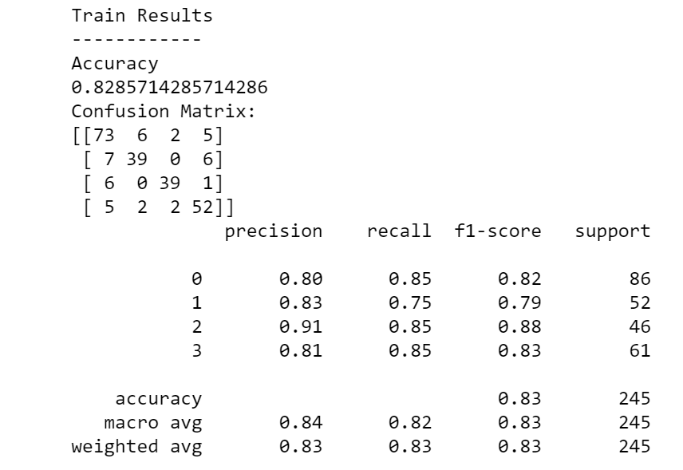
LOGISTIC REGRESSION (Optimized model)
Test Accuracy 77.14%
Train Accuracy 82.86%

Slide 18
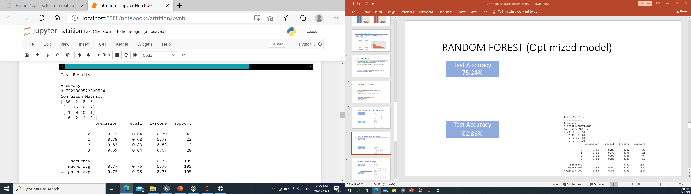
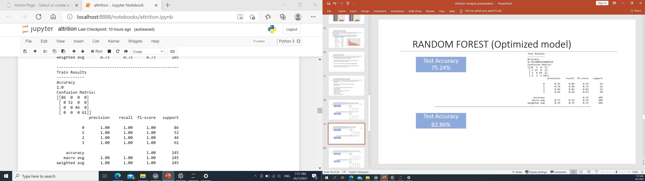
RANDOM FOREST (Optimized model)
Test Accuracy 75.24%
Test Accuracy
100.00%

Slide 19
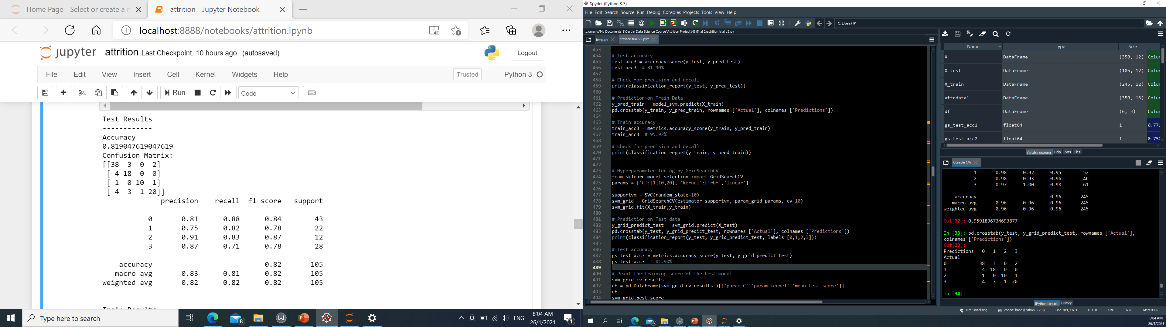

SUPPORT VECTOR MACHINE (Optimized model)
Test Accuracy 81.90%
Train Accuracy 95.92%

Slide 20
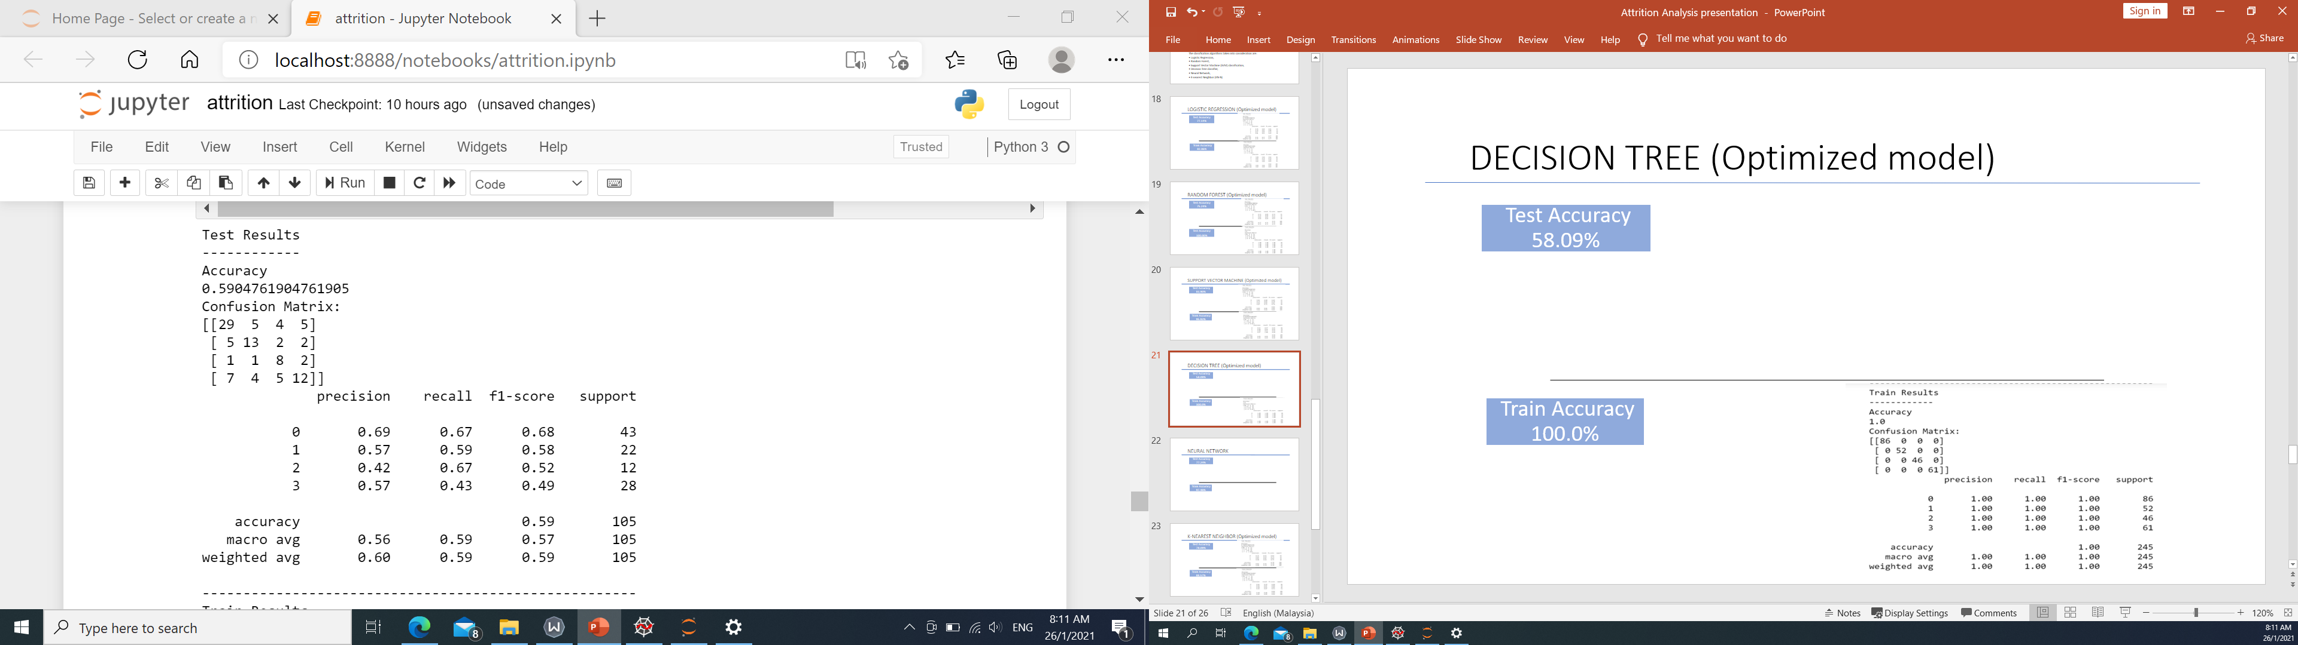
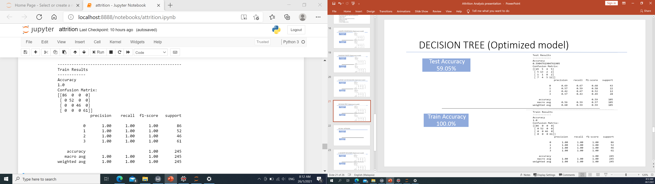
DECISION TREE (Optimized model)
Test Accuracy 59.05%
Train Accuracy 100.0%

Slide 21
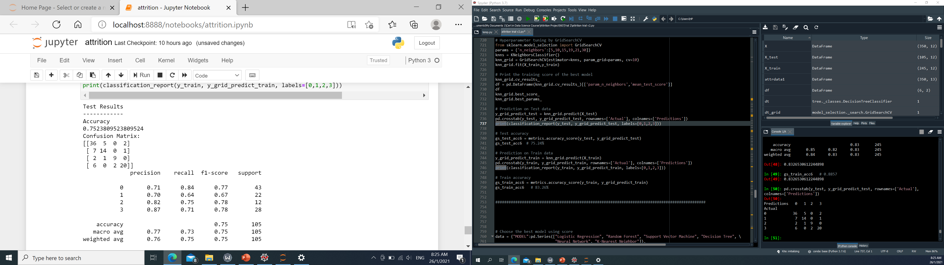
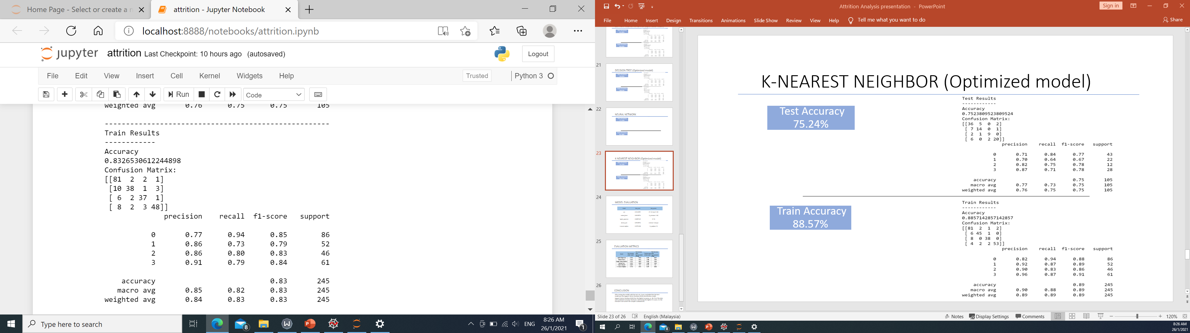
K-NEAREST NEIGHBOR (Optimized model)
Test Accuracy 75.24%
Train Accuracy 83.27%

Slide 22
MODEL EVALUATION
Model | best_score | best_params
logistic_regression | 0.771166666 | {'C’: 1, ‘max_iter': 50}
random_forest | 0.783 | {'n_estimators’: 100}
support_vector_machine | 0.83266666 | {'C’: 1, ‘kernel’:’rbf’}
decision_tree | 0.628 | {'criterion': 'entropy'}
k-nearest_neighbor | 0.775166666 | {'n_neighbors’: 10}

Slide 23
EVALUATION METRICS
Model | Test Accuracy (Initial model) | Test Accuracy (Optimized model) | Train Accuracy (Initial model) | Train Accuracy (Optimized model) | Precision (Optimized model) | Recall (Optimized model) | F1-score (Optimized model)
Logistic Regression | 0.771 | 0.771 | 0.829 | 0.829 | 0.670 | 0.830 | 0.740
Random Forest | 0.733 | 0.752 | 1.000 | 1.000 | 0.830 | 0.830 | 0.830
Support Vector Machine | 0.771 | 0.819 | 0.833 | 0.959 | 0.910 | 0.830 | 0.870
Decision Tree | 0.591 | 0.590 | 1.000 | 1.000 | 0.420 | 0.670 | 0.520
K-Nearest Neighbor | 0.743 | 0.752 | 0.886 | 0.833 | 0.820 | 0.750 | 0.780
Support Vector Machine classifier has the highest test accuracy, precision and F1-score.

Slide 24
CONCLUSION
After testing the models with the test set, it was concluded that the best model was the Support Vector Machine (SVM) classification model.
Support Vector Machine (SVM) has the highest accuracy, with 81.9% of the data predicted correctly.

Slide 25

WEB APPLICATION
https://analyticsattrition.herokuapp.com

Slide 26
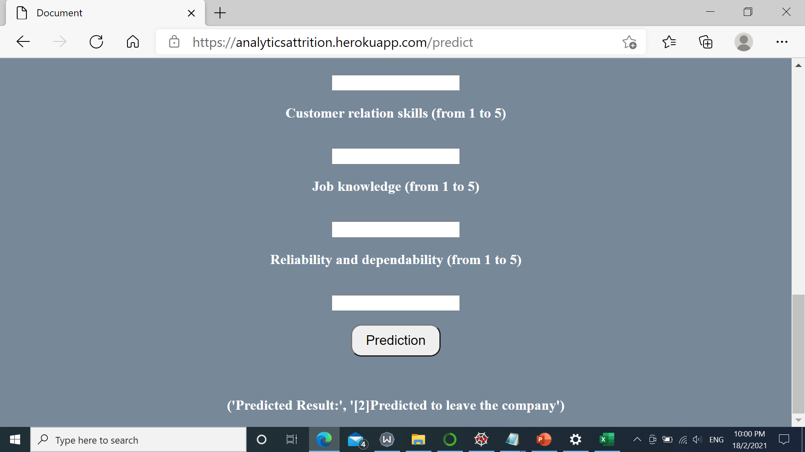
WEB APPLICATION
CLASS
Class 0 Permanent employee.
Class 1 Temporary employee.
Class 2 Predicted to leave the
company.
Class 3 Contractual employee.

